Slide 1
Road safety awareness (motorcycle)

Slide 2
Training objectives
Raise awareness among staff of the use of motorcycles at AAH
Remind people of the risks associated with riding motorcycles
Remind people of good driving and safety practices when riding a motorcycle

Slide 3
Summary
Introduction
Safety features of a motorcycle
The environment
Management of space
The driver
Conclusion

Slide 4
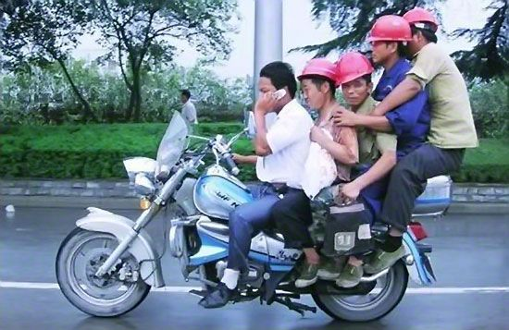
1. Introduction

Slide 5
Why do we need this awareness?
Road accidents are and remain the leading cause of death on our missions.
Not only have our colleagues died or been injured, but we have also caused the death of pedestrians, drivers or passengers of other vehicles.
Figures 2015-2020
 | UN | NGO
Deaths | 51 | 102
Injuries | 305 | 777
Deaths of children | 29 | 22
Injuries to children | 44 | 77
Notes:
Not only have our colleagues died or been injured in traffic accidents, but we have also caused the death of pedestrians, drivers, and passengers of other vehicles. Beyond the dramatic human loss, some incidents result in acceptance problems with a negative impact on AAH in its field of operations and on our national reputation.
Out of 28 traffic incidents in 2019, 50% are considered to have endogenous causes, either through lack of vigilance or protection, or due to drivers not following procedures, meaning they could have been prevented. In some extreme cases, accidents have resulted in the loss of life of our employees or community members.

Slide 6
AAH Motorcycle Use Policy
Motorbikes are used strictly within the framework of Action Against Hunger's activities and programmes in the countries of intervention. Motorbikes are only used when more "traditional" vehicles such as cars/trucks/boats cannot be used.
Roles and responsibilities
  Logistics
  Human Ressources
  Security
Terms of use
Allocation of equipment
Notes:
Logistics
The Logistics Focal Point, in addition to managing the fleet, is in charge of validating the driving tests, running the training and road safety awareness modules, allocating the equipment (motorbike) and supplying the minimum standard accessories. He is responsible for checking that the process has been carried out in full.
Human Resources
The Human Resources Focal Point is responsible for ensuring that the recruitment process is in line with the use of the motorbikes and that the conditions of use of the motorbike are communicated to the employee and that the employee agrees to respect them. They must also check that the document relating to the conditions of use is properly filed in the employee's file.
Security
The Security Focal Point is in charge of the preliminary risk analysis, which allows recommendations to be made regarding the content of training courses, travel rules and the equipment and accessories to be provided to the employee.

Slide 7
operational conduct
A method of driving which aims to reduce the risks
Take into account:
  The vehicle
  The environment
  The driver
THREAT
VULNERABILITY
RISK
RISK MITIGATION MEASURES
Notes:
This is the main objective of this awareness session: to provide the essential elements of the operational driving of a motorcycle in the framework of AAH activities

Slide 8
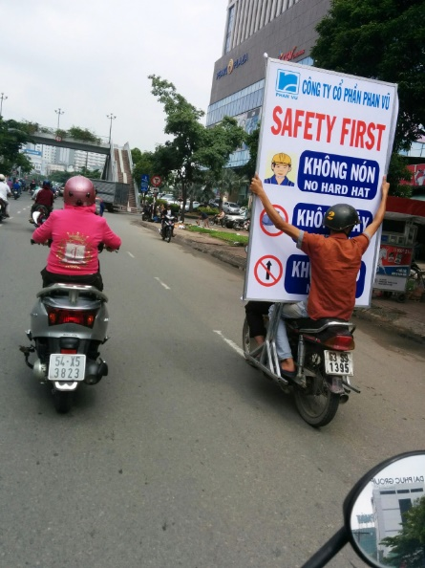
2. Motorcycle safety features

Slide 9
security features
What are the safety features on a motorcycle?
Tires (break-in, wear, inflation)
Brakes (cables and pads)
Headlights
Warning devices (indicators, horn)
Mirrors
Loading (duo, luggage)
Fluid levels

Slide 10

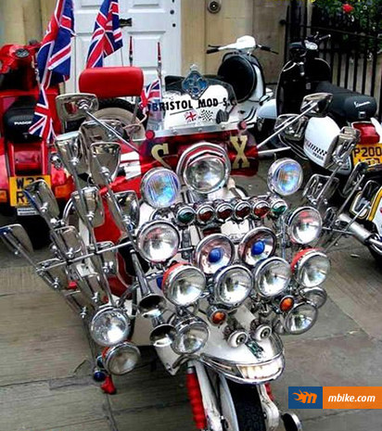
Headlights
In order to see :
  During the night
  Under the rain
  In the mist or the dust
  2. To be seen :
  During the night
  During the day! Attracts attention
  3. As soon as the brightness decreases:
  Remember to lower your lights when passing other vehicles
  Check headlights' condition regularly

Slide 11

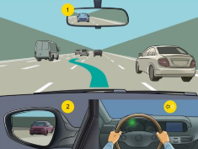
Indicators
To communicate your intentions:
  To turn (change direction),
  To maneuver,
  To signal a danger (warning lights).
In all situations and even if you do not see other pedestrians / vehicles!

Slide 12
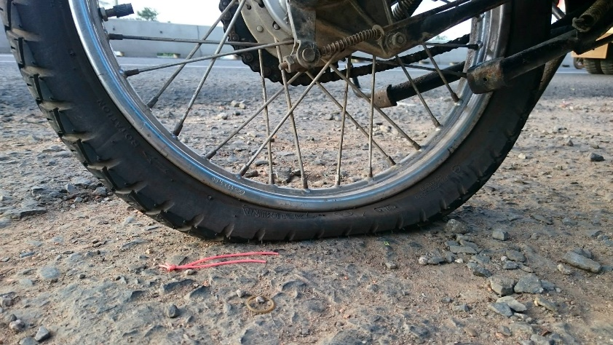
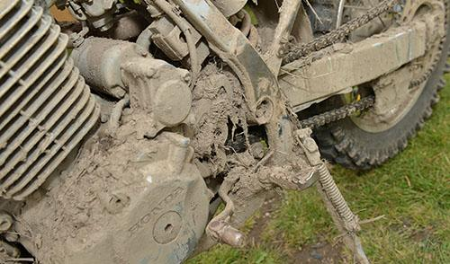

Maintenance
Proper functioning
  Daily checks before departure
  Regular checks, controls and maintenance
Cleanliness
  Hygiene
  Visibility
Adapted motorcycle
  To the needs
  Good use

Slide 13
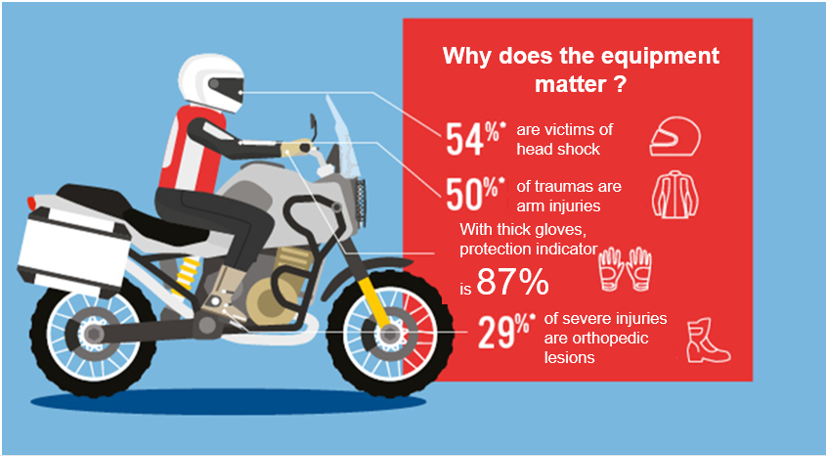
EQUIPMENT
Notes:
Minimum attire required to ride a motorcycle:
Helmet (provided by AAH)
Close-toed shoes
Resistant jacket
Resistant pants
Mandatory identification equipment (provided by AAH - depending on the mission's security policy)

Slide 14
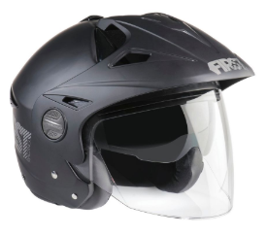
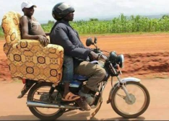
the helmet!
The most effective protection
Must be worn at all times
And fastened!
Remember that you are naked facing the road!
Boots, gloves, long sleeves, pants,...

Slide 15
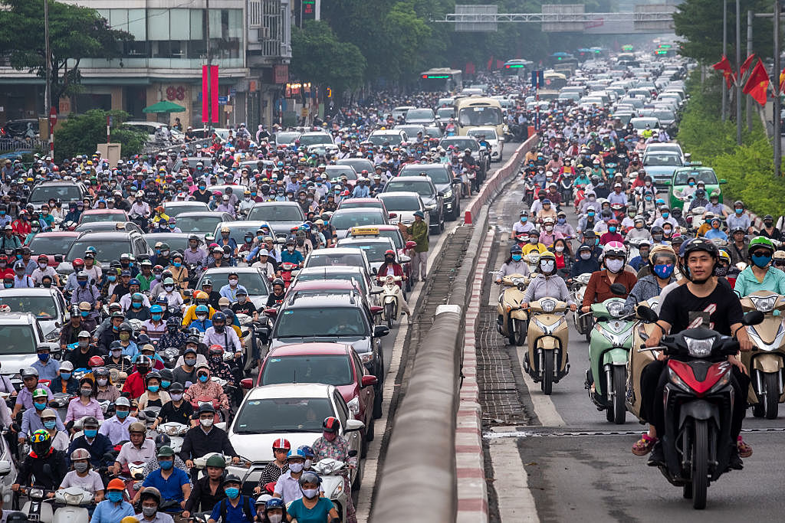
3. The environment

Slide 16
The environment
What are we talking about and how does it affect your vehicle?
The road
Climate/weather
Other users:
  Cars, trucks, motorcycles
  Pedestrians, bikes
Hazards:
Constantly changing
Powerlessness to act upon it
You can only be vigilant
Knowledge of risk areas in urban and rural areas

Slide 17
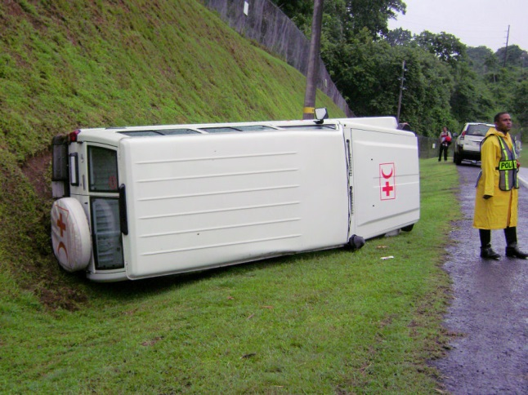
The road
Influence of traction
  On wet roads
  On the tracks
Influence of driving skills
  Narrow roads, with curves and intersections
  Monotonous, wide and hypnotic roads
Pay attention
  Signaling
Be aware and be seen
  In the curves
  In the crossing of hills
Caution :
Adjust your speed!

Slide 18
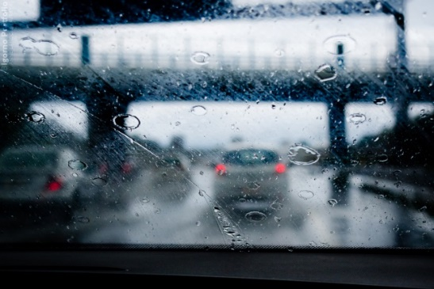
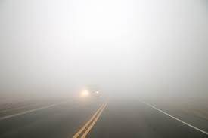

The weather
Rain
  Wet road = less traction
  Limited visibility
  Check the tires
  Risk of accidents 2x higher in case of rain
  Fog
  Limited visibility
  Strong winds/Gusts
  Deflection of the vehicle
  Load (pick-up)
  Sun
  Glare risk

Slide 19
Other users of the road...
Users = everyone on the road
  Cars, trucks, motorcycles
  Pedestrians, bicycles
  Animals
Always moving/never predictable
Solutions:
  Stay alert
  Anticipate
  Warn (headlights, horn...)
  Make sure you are seen
Drive for yourself and others!

Slide 20
To summarize
Out of control
Anticipate and adapt
Out of control
Anticipate and adapt
Out of control
Anticipate and adapt
The road
The weather
Other users

Slide 21
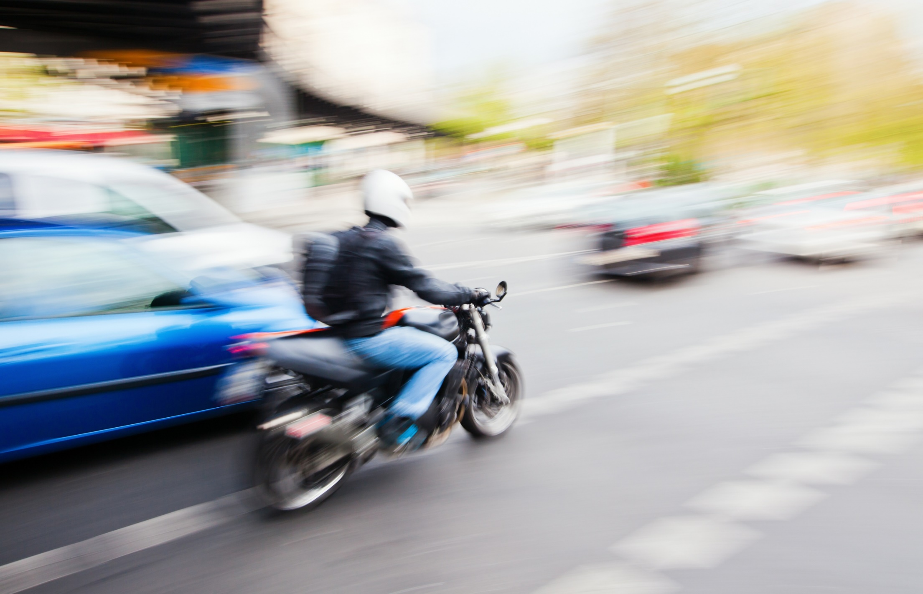
4. Management of space

Slide 22
Management of space
Understand each other's place
Choose an open road
Keep your safety distance even when stopped
Estimate distances

Slide 23
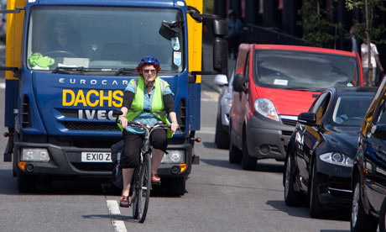
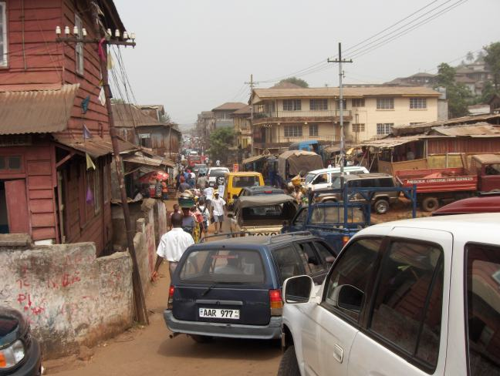
Management of space

Slide 24
Management of space
When am I too close?
The three-second rule
Be able to stop at least half the visible distance
Adapt your speed
Add 1 second for each hazard

Slide 25
Passing and being passed
Passing = take a risk :
  Don't do it if you don't have to
  Always announce your intention
  Always stay in control / analyze
  Beware of prohibitions / signaling constraints / road traffic....
Being passed
  Caution
  Leave enough space
  Maintain or reduce your speed. DO NOT SPEED UP
Fish tails or sticky drivers :
  Leave space for overtaking
  Do not seek revenge respond to aggressiveness with courtesy.

Slide 26
Reaction time
Time to respond to an incident
  Average = 1 second
During this time, the vehicle keeps moving forward.
Factors affecting reaction time:
  Lack of concentration
  Poor physical condition
  Alcohol, drugs, medication
  Poor visibility

Slide 27
Braking distance
Distance traveled while braking.
Due to inertia, you will never be able to stop the vehicle immediately. The braking distance depends on:
  The vehicle's condition : brakes, tires, suspensions
  Condition of the road: asphalt, track, wet, dry...
  Braking efficiency: driver skills
  Speed => main factor!
Braking distance in motorcycle is longer than in car!
Emergency braking is particularly dangerous (much more than in a car)

Slide 28
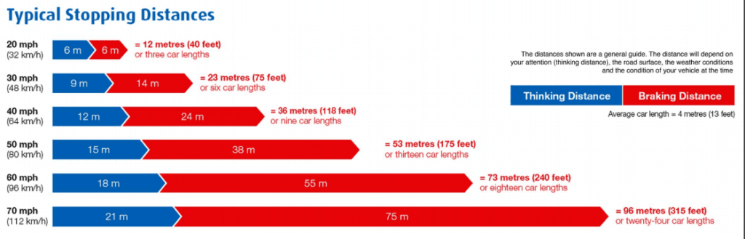
Stopping distance
Distance changes between the moment the driver perceives the danger and the moment the vehicle comes to a complete stop
Reaction distance + braking distance
Adapt your speed!

Slide 29
Speed
Speed and stopping distance
Speed and impact force
Speed and cost
Give yourself time to slow down
AAH Rules :
  In town (villages included) = 50 Km/h
  Rural roads = 80 Km/h
  Maximum speed!!

Slide 30
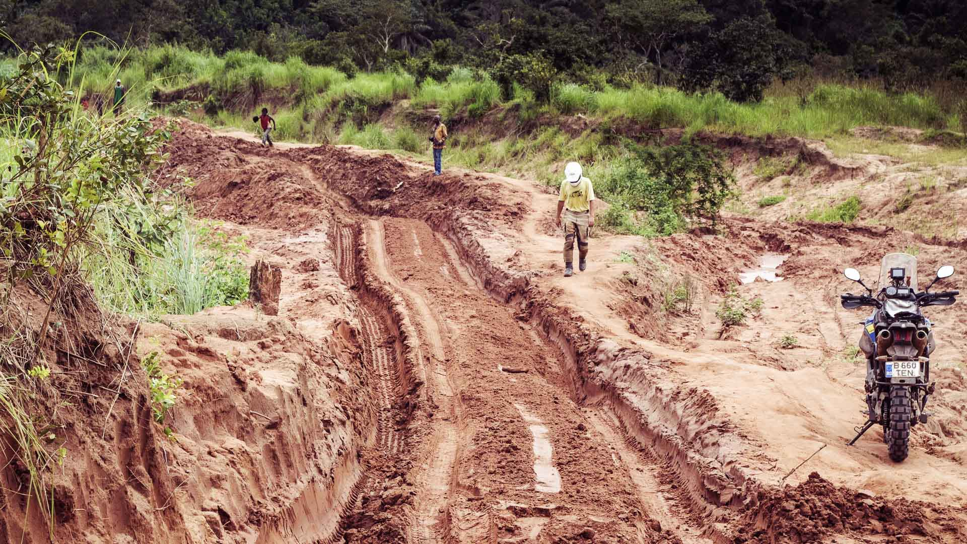
5. The Driver

Slide 31
What kind of driver are you?
The distracted one?
  Plan your day? have a snack or drink coffee? Think ?
The shy one?
  Nervous? Impressed by traffic? Difficulty making a decision? Lack of confidence?
The agressive one?
  Cut in in front of other users? Get out of your way? Aggressive? If so, think of the other users
The fast one?
  First arrived! Or a little behind schedule?
The sleepy one?
  Soothed by the purr of the engine...
The undecided one?
  Should I change lane? Should I pass this car? Is this the right intersection? Can I go this way?
The automatic one?
  Same road, same lights, same vehicle, same weather, same traffic every morning... until it changes
The good one?
  We all are a little bit each of these drivers
  Try to stay alert and to prevent these behaviors

Slide 32
Behaviours
Focus
  The driver must be 100% dedicated to his/her driving
Health
  No alcohol, drugs or medication
  Rested (fatigue = main cause of accidents)
  Act (Observe, move...)
Competence
  Trained driver
  Know your limits

Slide 33
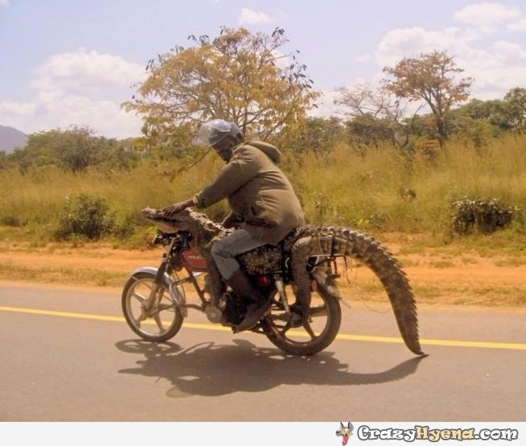
distractions
Visibility/ Obstruction
Passengers
Distractions made by the driver:
Phone, cigarette, music,
  eating, drinking…
You are solely responsible for your motorcycle and your driving.
You are responsible for compliance with the rules

Slide 34
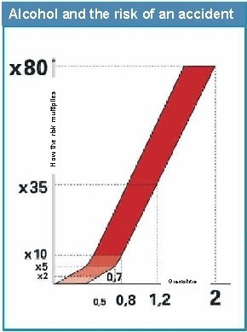
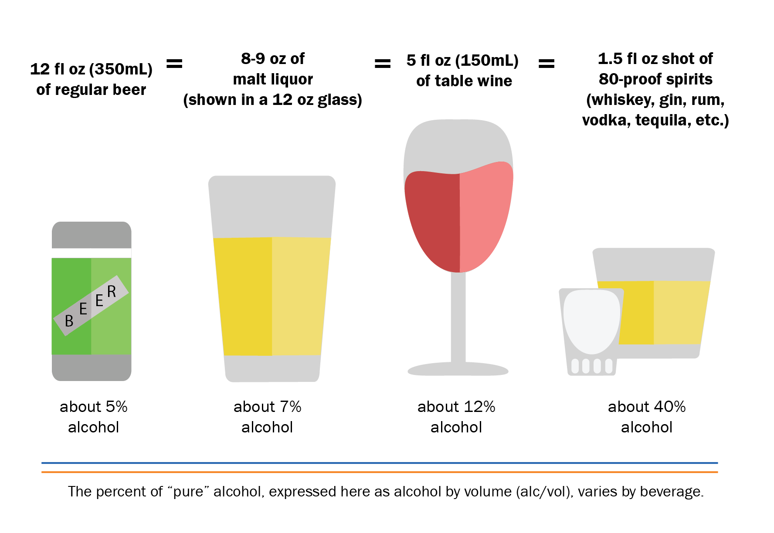
Alcohol While Driving
1. One of the most important causes of accidents
  Reduces the field of vision
  Increases reaction time
  Slower and less precise driver
  Increases fatigue
  Modifies perceptions
  Risk Taking
2. AAH Rules :
  No alcohol at all during or before work
  1 hour needed to eliminate each drink with a minimum of 5 hours before being sober
  Ex: 2 drinks = 5+1+1= 7 Hours before being totally sober

Slide 35
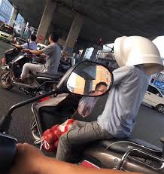
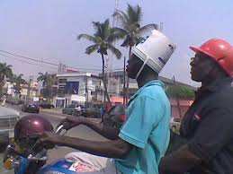
6. conclusion

Slide 36
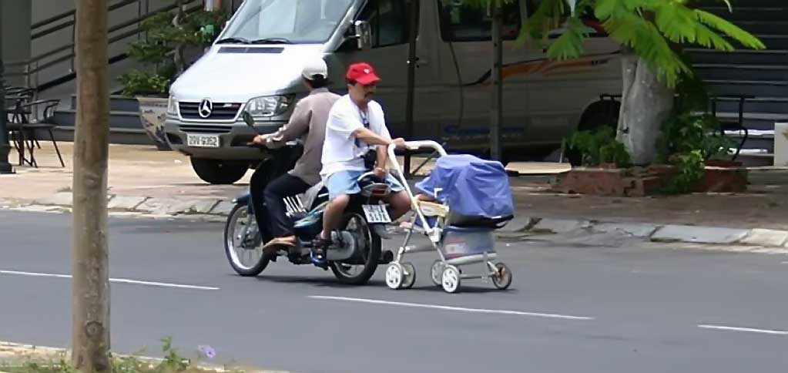
To summarize
Some sources of stress cannot be controlled
No need to panic or become aggressive
Some sources of stress, on the other hand, must be controlled, such as the driver's behavior
Be polite and respectful

Slide 37


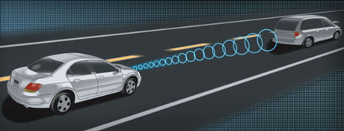
Basic Principles : reminder
Anticipate
  Other users' reaction (speed)
  Road hazards
See and be seen
  Observe your environment and gather useful information
  Make sure that other users can see me and take me into account
Manage space
  Be in the right place on the road
  Keep safe distances

Slide 38
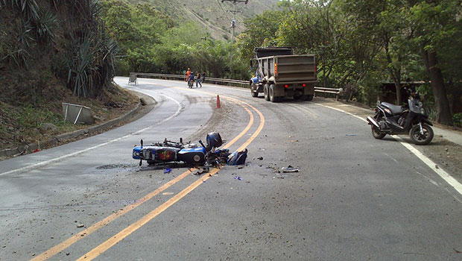
Accidents don't just happen to other people...!

