Slide 1


Defining the needs of the fleet management community

Slide 2

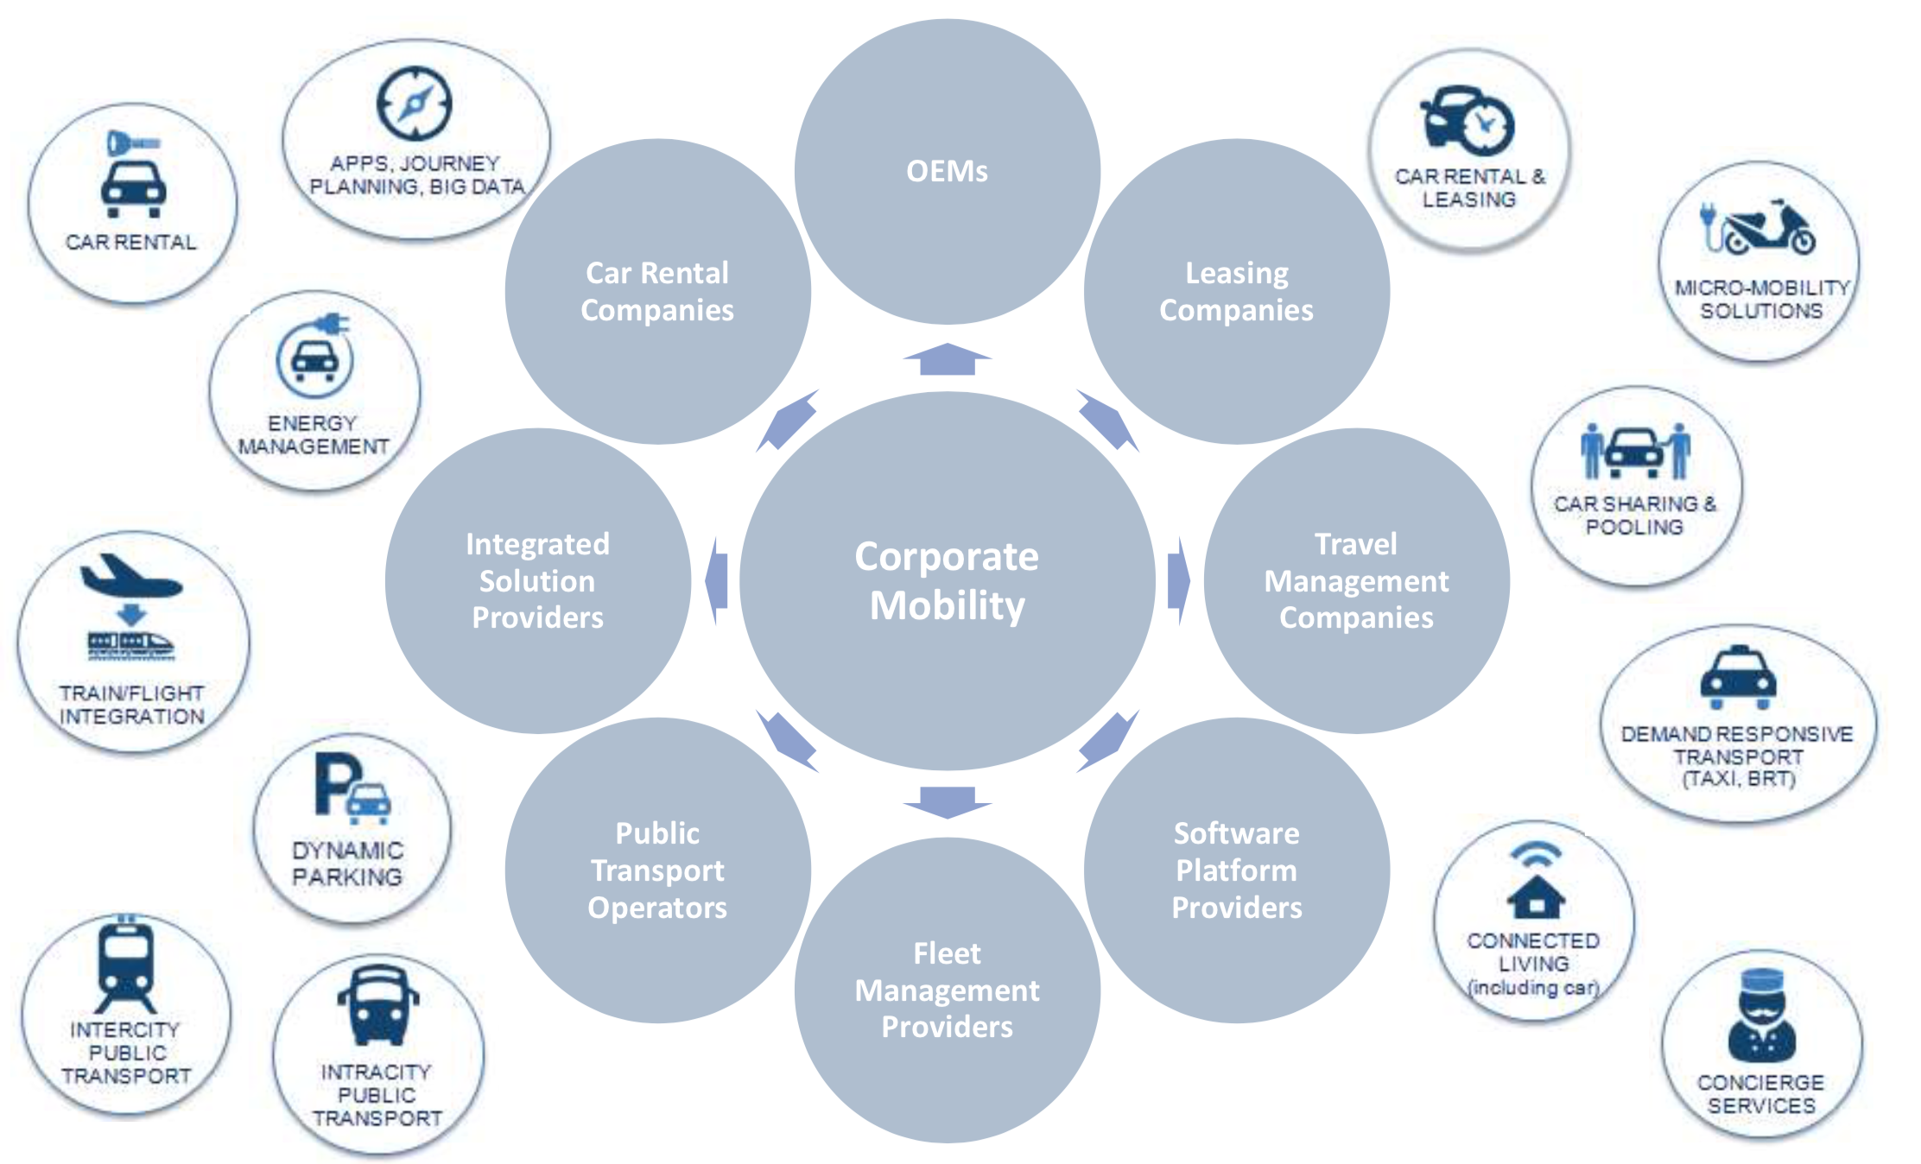
Mega Trends Reshaping Transportation

Slide 3
Four Possible Future States
3. The Driverless Revolution
4. A New Age of Accessible Autonomy
Autonomous
Vehicle control
1. Incremental Change
2. A World of Carsharing
Driver
Personal
Shared
Vehicle ownership

Slide 4

Four Possible Future States
Own vehicles. Maintain flexibility, security and convenience
Ridesharing and carsharing among agencies. No ownership
Autonomous
Operate autonomous vehicles, no need to hire drivers
Operate autonomous vehicles, no need to hire drivers
Vehicle control
Own vehicles. Maintain flexibility, security and convenience
Ridesharing and carsharing among agencies. No ownership
Retain drivers. Use driver-assist technology to limit safety risks
Retain drivers. Use driver-assist technology to limit safety risks
Driver
Personal
Shared
Vehicle ownership

Slide 5
Build Your Organisation’s Cover Story
Notes:
Before the meeting, draw out large-scale templates that include the categories shown on the following image. Your template doesn’t need to look exactly like this one; you can be creative with the central image and the layout. Just be sure to keep the categories intact. The number of templates you create depends on the size of the group. At the most, allow four to six people to work on one template together.
Explain the object of the game to the players and define each category on the template:
• “Cover” tells the BIG story of their success.
• “Headlines” convey the substance of the cover story.
• “Sidebars” reveal interesting facets of the cover story.
• “Quotes” can be from anyone as long as they’re related to the story.
• “Brainstorm” is for documenting initial ideas for the cover story.
• “Images” are for supporting the content with illustrations.
Break the players into groups of four to six and make sure there are markers and one template for each group. Tell the players that to populate the template they can either select a scribe or write and draw on it together.
Ask the players to imagine the best-case scenario for their company and to take that scenario one step further. Request that they spend five quiet minutes imagining their own stories before they work together to agree on one. Give the groups 30–45 minutes to generate this “story of the year” and represent it on their template.
Reconvene the breakout groups and ask for volunteers to present their visions first. Give each group 5–10 minutes to share what they imagined was written in the story and the supporting elements.
Note any common vision themes and areas of agreement. Ask for observations, insights, and concerns about the future state.

Slide 6
Questions
What is the big success?
What is the substance of the story?
What are some interesting facets?
What are people in your organisation saying?
What images come to my mind?
Notes:
• “Cover” tells the BIG story of their success.
• “Headlines” convey the substance of the cover story.
• “Sidebars” reveal interesting facets of the cover story.
• “Quotes” can be from anyone as long as they’re related to the story.
• “Brainstorm” is for documenting initial ideas for the cover story.
• “Images” are for supporting the content with illustrations.

Slide 7
Overcoming Challenges on the Way
Notes:
Before the meeting, draw out large-scale templates that include the categories shown on the following image. Your template doesn’t need to look exactly like this one; you can be creative with the central image and the layout. Just be sure to keep the categories intact. The number of templates you create depends on the size of the group. At the most, allow four to six people to work on one template together.
Explain the object of the game to the players and define each category on the template:
• “Cover” tells the BIG story of their success.
• “Headlines” convey the substance of the cover story.
• “Sidebars” reveal interesting facets of the cover story.
• “Quotes” can be from anyone as long as they’re related to the story.
• “Brainstorm” is for documenting initial ideas for the cover story.
• “Images” are for supporting the content with illustrations.
Break the players into groups of four to six and make sure there are markers and one template for each group. Tell the players that to populate the template they can either select a scribe or write and draw on it together.
Ask the players to imagine the best-case scenario for their company and to take that scenario one step further. Request that they spend five quiet minutes imagining their own stories before they work together to agree on one. Give the groups 30–45 minutes to generate this “story of the year” and represent it on their template.
Reconvene the breakout groups and ask for volunteers to present their visions first. Give each group 5–10 minutes to share what they imagined was written in the story and the supporting elements.
Note any common vision themes and areas of agreement. Ask for observations, insights, and concerns about the future state.

Slide 8
Challenges Described by Participants
Introducing change and transformation at global level
Capacity building of internal staff in fleet management
Actual implementation and understanding of how best to utilize the systems and data to make smarter decisions
Organizational behaviour with regard to fleet management
Notes:
• “Cover” tells the BIG story of their success.
• “Headlines” convey the substance of the cover story.
• “Sidebars” reveal interesting facets of the cover story.
• “Quotes” can be from anyone as long as they’re related to the story.
• “Brainstorm” is for documenting initial ideas for the cover story.
• “Images” are for supporting the content with illustrations.

Slide 9
What do you need in the next three years?
The outcome of this session will shape Fleet Forum Development Agenda 2019-2020

